Slide 2
Indent
To define sub task(s) of any task, indentation is used.
The parent task is known as the Summary task.
The child task are referred as simply task or sub task.
How to Indent a Task?
Either click the task row that you want to indent or outdent, and then, on the Task tab, in the Editing group, click Indent or Outdent.
Or click the task row that you want to indent or outdent. To indent the task, press Alt + Shift + Right arrow. To outdent the task, press Alt + Shift + Left arrow.
See Slide number 3 for reference.

Slide 3
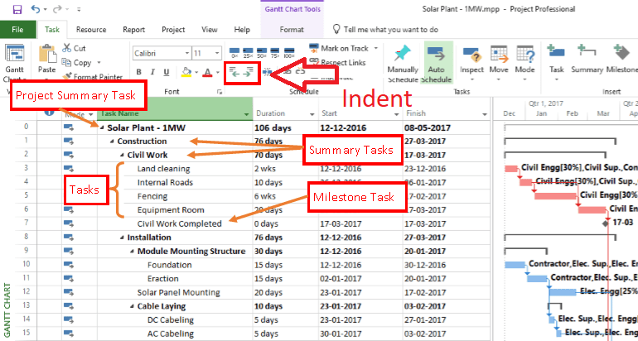

Slide 4
Milestone
A milestone is simply a way to mark an important point in the project.
Examples could include:
Project kick-off
Design complete
Phase 1 complete
Documents finalized
Milestones help identify how much work has been done.
See Slide number 6 for reference.

Slide 5
How to Make a Task Milestone?
A task can be marked as a milestone by simply changing the duration to 0 days.
The other way to define a milestone is:
Double click a task
Task information will pop up
Go to Advance tab
Lower left corner will have a check “Mark task as milestone”
Click Ok.

Slide 6
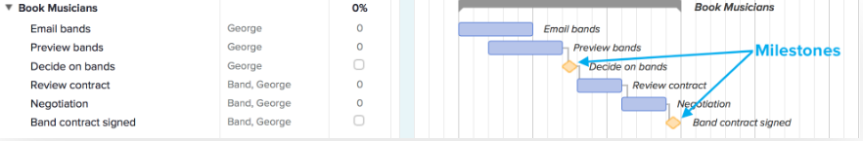

Slide 7
Task Mode
The Task Mode field is the first field in the Gantt Chart Sheet.
The Task Mode field indicates whether a task is scheduled manually or automatically, which gives you the option of deciding how much control you want over task scheduling in a project. By default, tasks are set as manually scheduled, with a start date, finish date, and duration that you define.
If you wish to switch the task mode to Automatically mode, you just need to define the duration of each task, the start date and finish date will be adjusted by MS Project using the Project Information.
Project Information was discussed in the Zoom Session 1.

Slide 8
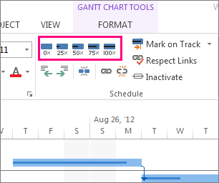
Task Completion
To create a Tracking Gantt Chart it is important to update the percentage of work done in a particular task.
How to Define Task Completion?
You can select the percentage work done from the ribbon for each task.
The other way is:
Double click a task
Task information will pop up
Go to General tab
Enter the percentage in the “Percentage Comple” field.
Click Ok.

